Slide 1
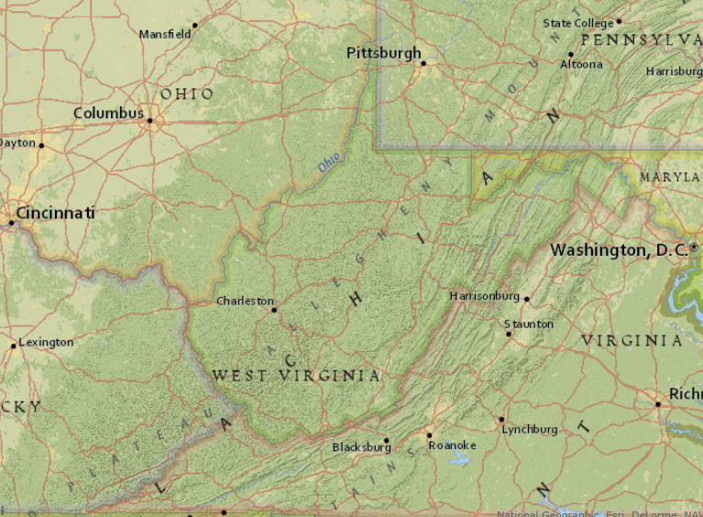
ArcGIS
Statewide
K12 License
Update
Notes:
Introduction: Statewide K12 license, managed through WVDE, I manage license, training.

Slide 2

Erika Klose
WVDE and Winfield Middle School
USGS Geologist / GIS user turned teacher
Manage WV K12 statewide license and train WV teachers

Slide 3

NGSS Standards Connections
Science and Engineering Practices
  1. Asking Questions and Defining Problems
  2. Developing and Using Models
  3. Planning and Carrying Out Investigations
  4. Analyzing and Interpreting Data
  5. Using Mathematics and Computational Thinking
  6. Constructing Explanations and Designing Solutions
  7. Engaging in Argument from Evidence
  8. Obtaining, Evaluating, and Communicating Information

Slide 4
K12 Statewide License Status
Current license:
  Just renewed through 2017
  Covers both academic and administrative use
Current teachers trained:
  257 teachers trained and receiving regular updates
  Current focus is ArcGIS.com
  First level trainings solely ArcGIS.com
Scheduling Spring trainings now
Career and tech update

Slide 5
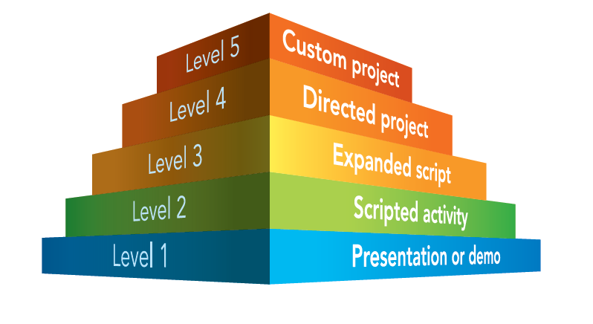
Encouraging the use of ArcGIS as a “comprehensive” teaching tool

Slide 6
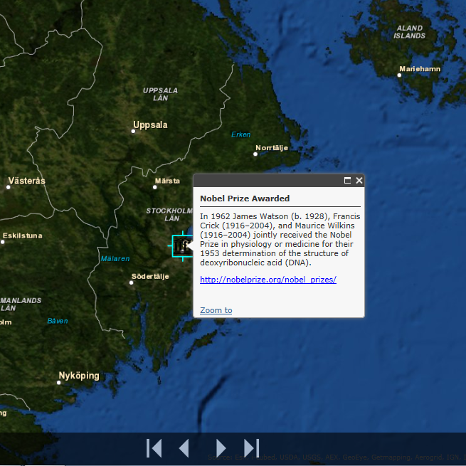
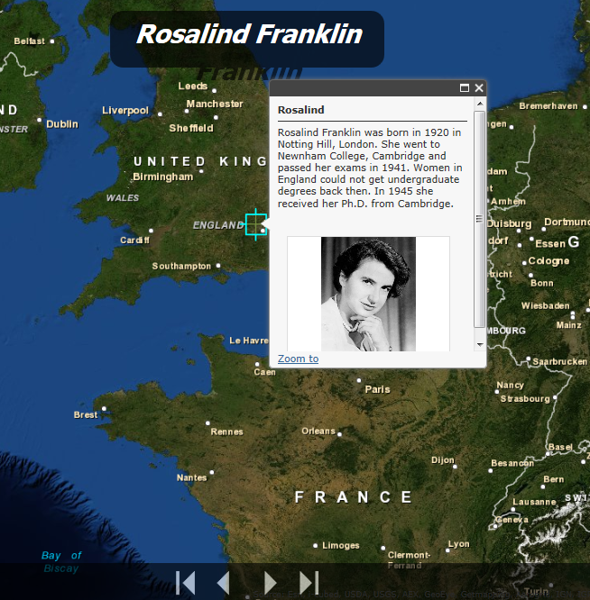
Encouraging the use of ArcGIS as a “comprehensive” teaching tool

Slide 7
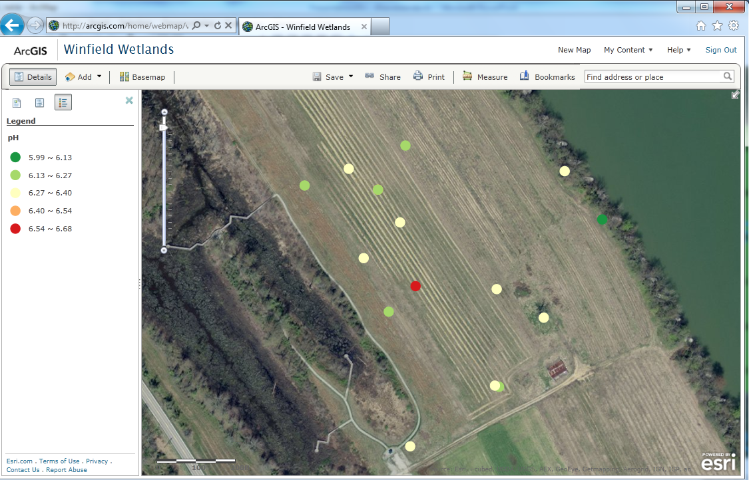

Encouraging the use of ArcGIS as a “comprehensive” teaching tool

Slide 8
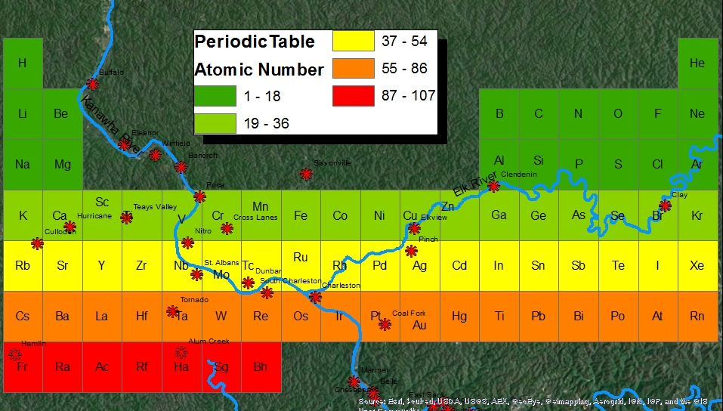
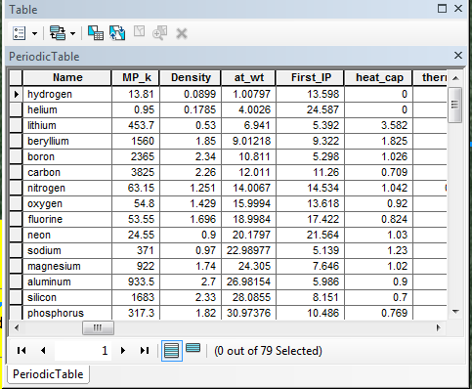
Make it spatial if it’s not!

Slide 9
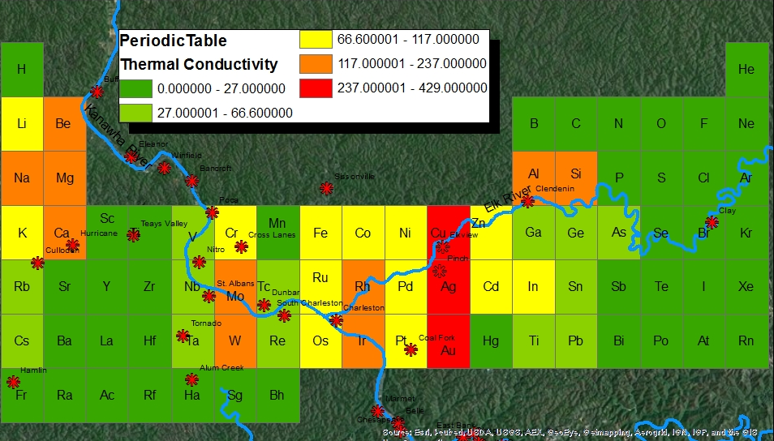
Make it spatial if it’s not!

Slide 10
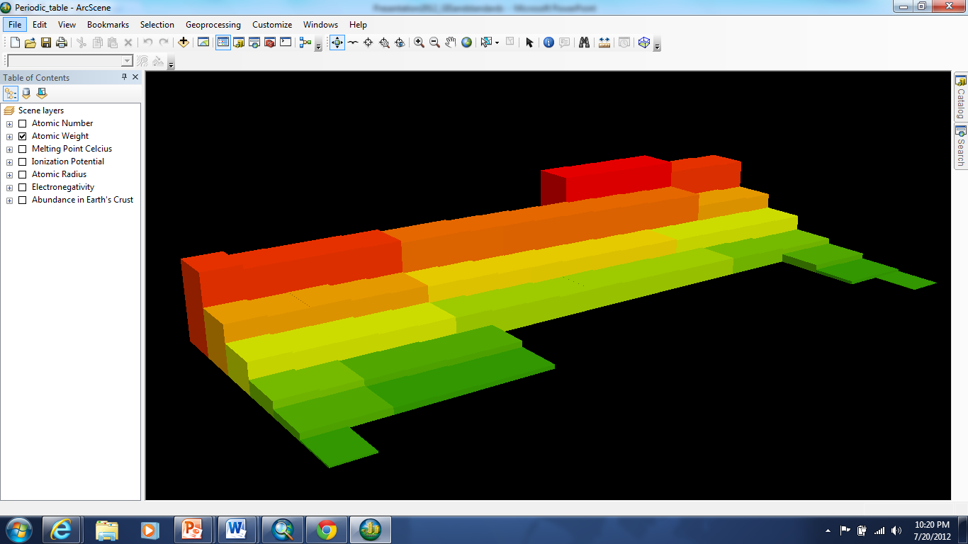
Use all the capabilities!

Slide 11
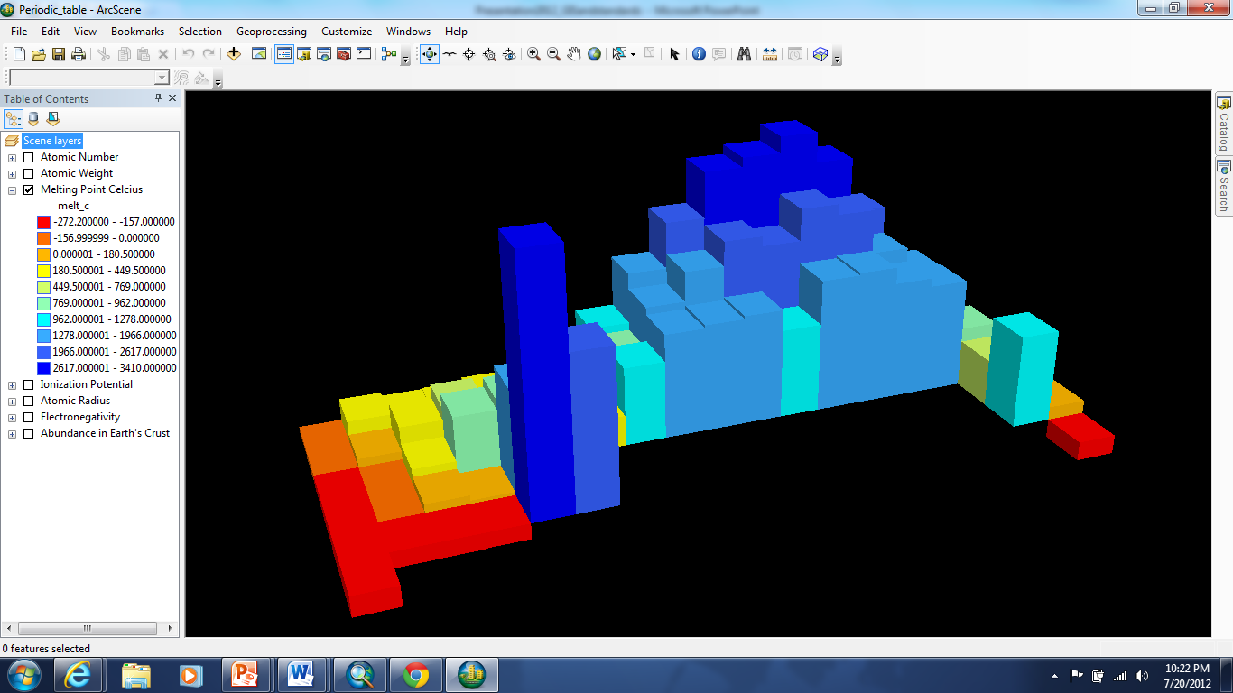
Use all the capabilities!

Slide 12







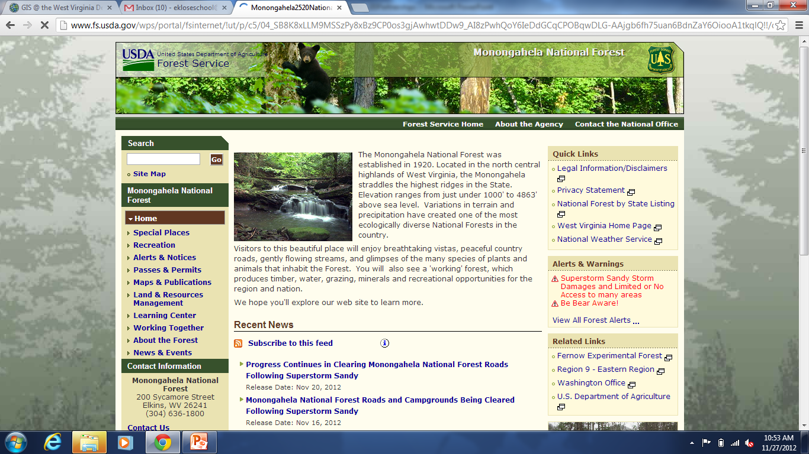
Bringing varied content to teachers would be impossible without our GIS Partners!

Slide 13
Bringing varied content to teachers would be impossible without our GIS Partners!
Ongoing GLOBE training (GPS, GIS, and data collection) which incorporates ArcGIS products.

Slide 14
Bringing varied content to teachers would be impossible without our GIS Partners!
GIS Technical Center applied for broadband grant ; working to create specific data services for educational needs. GISTC also creating a 1-day course in ArcGIS.com and adapting to K12 teachers and administrators.

Slide 15
Bringing varied content to teachers would be impossible without our GIS Partners!
TMI received a grant award from NOAA/NGS – will provide teacher training in data collection using ArcGIS (Online and Desktop).

Slide 16
Bringing varied content to teachers would be impossible without our GIS Partners!

Slide 17
How can you help?
http://wvde.maps.arcgis.com/home/
Connect with one of our partners –
Share expertise and data
Make a map! – Send it along to me!
Share data, news, etc.
Thanks!
eklose@acces.k12.wv.us

