Slide 1
Framework Data Development and Web Map Services
WV GIS Technical Center
27 Nov 2012
Kurt Donaldson

Slide 2
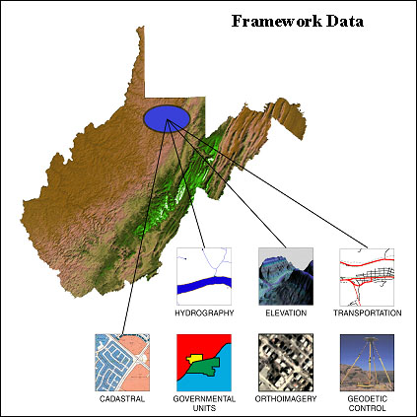
Framework Data Report
Framework Data
WVGISTC Website
http://www.wvgis.wvu.edu/resources/resources.php?page=dataProductDevelopment/baseLayers

Slide 3
Internet Map Services – Public Demand
Question: Does WV offer interactive mapping that includes layers such as: Parcels, Roads, ROW, Subdivisions, Land marks, etc that the public can search? I'm particularly interested in Wayne County. Ohio offers the following resource –
http://www.dalisproject.org/pages/imsweb.htm. The general tab will take you to the interactive map.
Thanks,
Jerrit
Delaware County, Ohio
26 November 2012

Slide 4
Statewide Imagery
Statewide Digital Imagery
1996-99 USGS DOQQ, 1-meter CIR, leaf off
2003 SAMB, 2-ft natural color, leaf off
2007 USDA NAIP, 1-meter, leaf on, natural color & CIR
2009 USDA NAIP, 1-meter, leaf on, natural color
2011 USDA NAIP, 1-meter, leaf on, natural color & CIR
2010-12 WV Sheriff Association (Pictometry), 1-ft (4” urban areas) natural color, mostly leaf-off, oblique and orthogonal imagery, license restrictions
Web Map Services (Viewing Only)
WV DNR: http://tagis.dep.wv.gov/mapservices2.html
WVGISTC: http://services.wvgis.wvu.edu/ArcGIS/rest/services

Slide 5
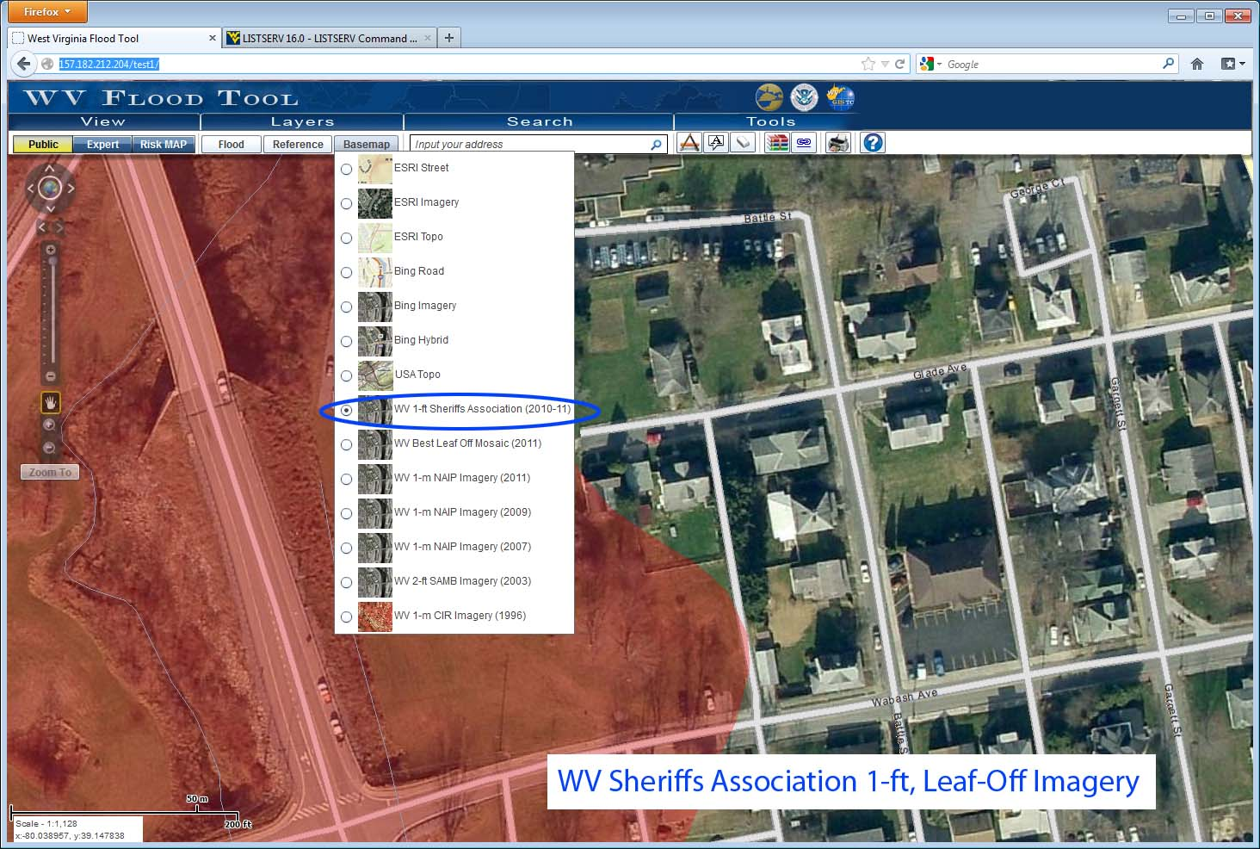
WV Sheriffs Association Imagery
WVGISTC Web Map Service
Web: http://services.wvgis.wvu.edu/ArcGIS/rest/services
ArcMap: services.wvgis.wvu.edu/ArcGIS/services

Slide 6
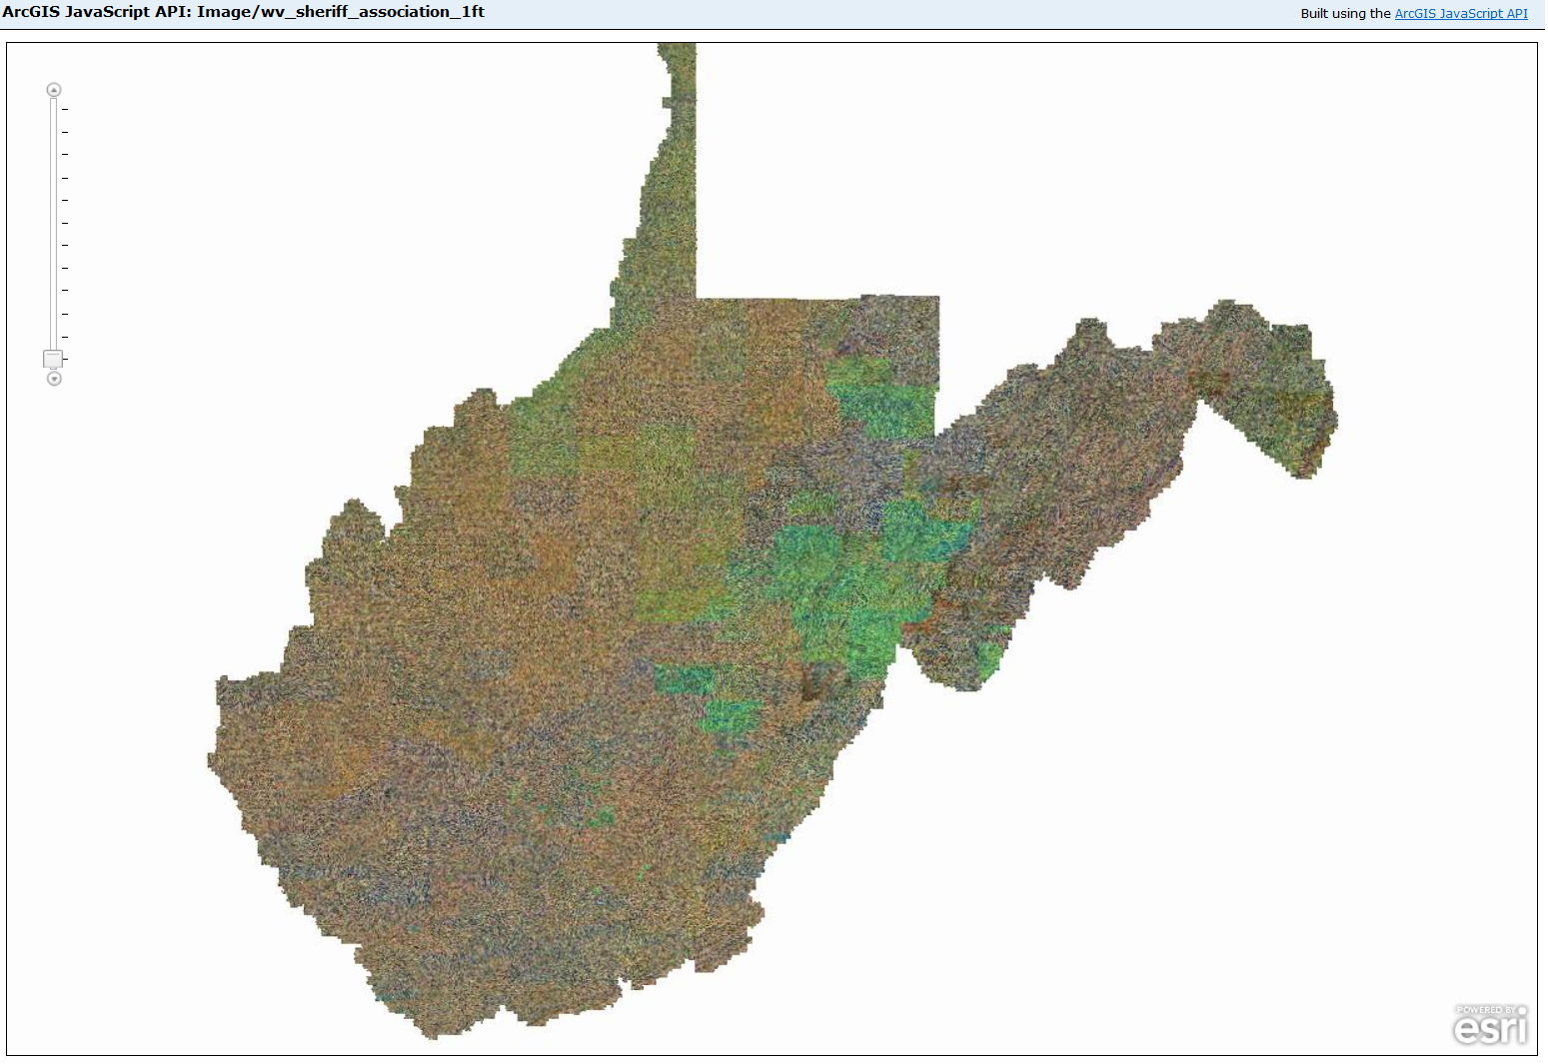
2010-11 WV Sheriffs Imagery (12 “)
Statewide Web Service

Slide 7
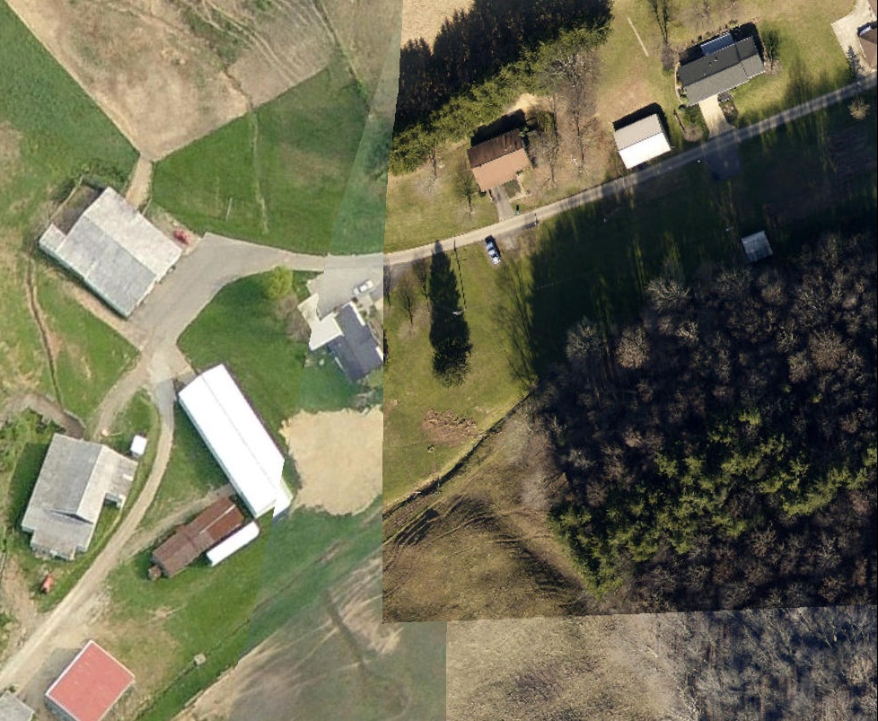
WV Sheriffs Imagery – 12” & 4”
12 inch
4 inch
Scale 1:1,128

Slide 8
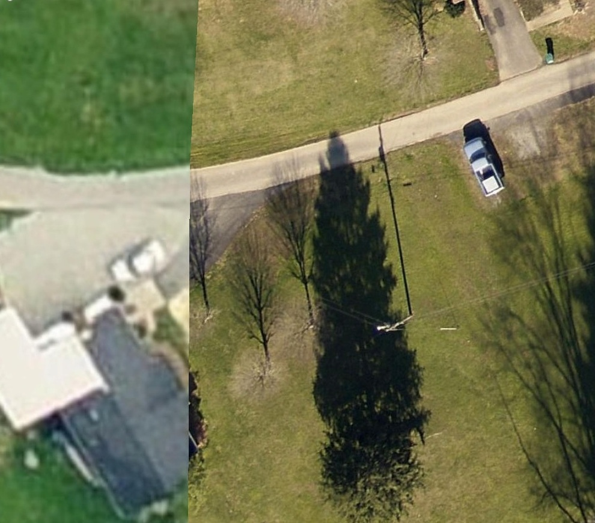
WV Sheriffs Imagery – 12” & 4”
12 inch
4 inch
Scale 1:282

Slide 9
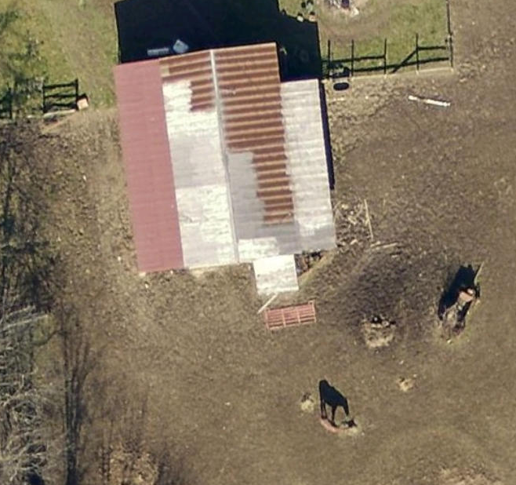
WV Sheriffs Imagery – 4”
4 inch
Find the horse?

Slide 10
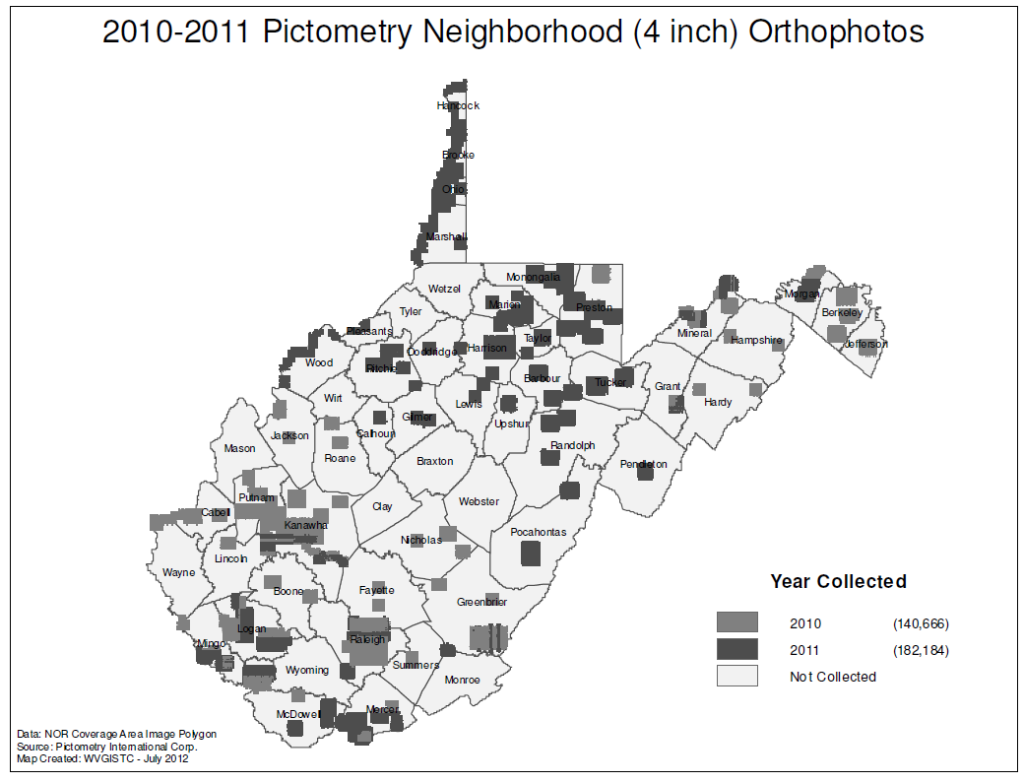

Slide 11
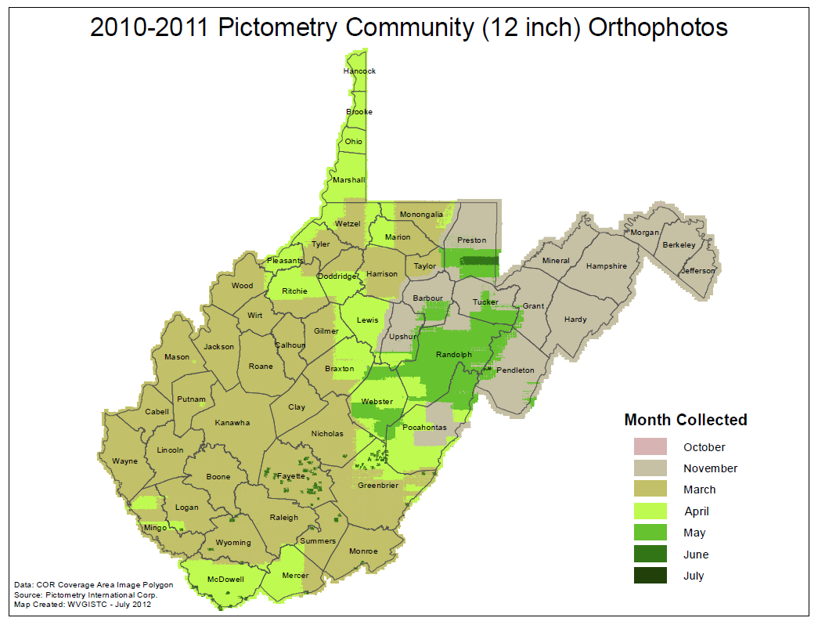

Slide 12
Statewide Imagery (Cont.)
Statewide Leaf-Off Imagery Mosaic (Best-Available Leaf Off)
** Imagery compiled from county and others sources **
Bluestone Lake (USACE, 2009)
Cabell County (2009)
Brooke County (2007)
Hancock County (2007)
Monongalia County (2010)
Raleigh County (2011)
Some counties make their 6” imagery available in the public domain, other counties for viewing as a Web map service only.
WVGISTC Web Map Service
Web: http://services.wvgis.wvu.edu/ArcGIS/rest/services
ArcMap: services.wvgis.wvu.edu/ArcGIS/services

Slide 13
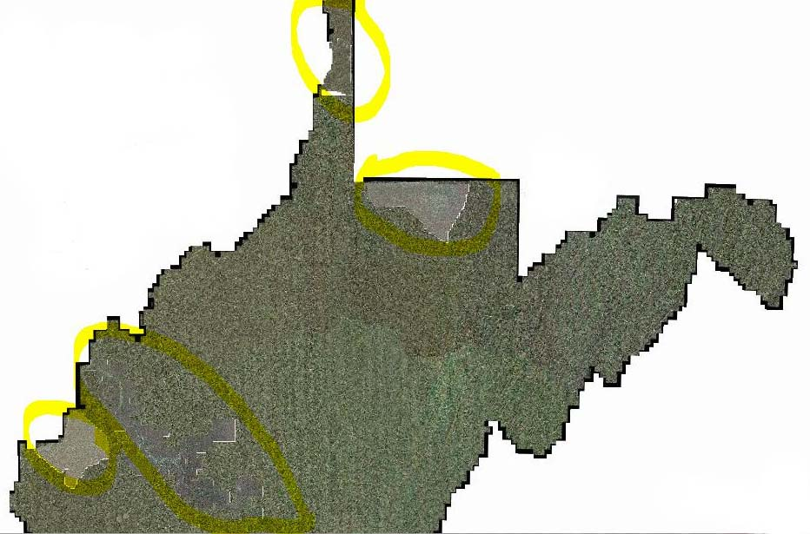
Best Leaf-Off Imagery
High resolution imagery for Charleston, Huntington, Morgantown, and Weirton areas incorporated into SAMB 2003 statewide leaf-off imagery
Recently Received a Broadband Grant to Update Best Leaf-Off Imagery Service

Slide 14
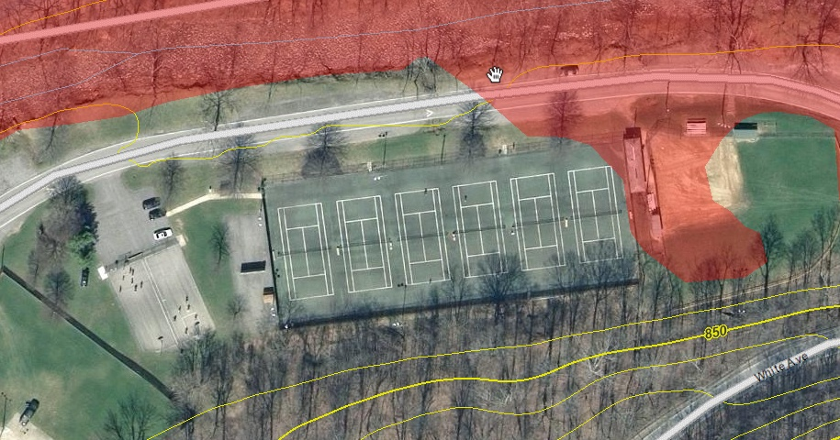
Best Leaf-Off Imagery –
Monongalia County
2010 High Resolution Imagery
(1” = 100’, 0.5 ft. pixels)
Marilla Park, Morgantown, WV
See the people?

Slide 15
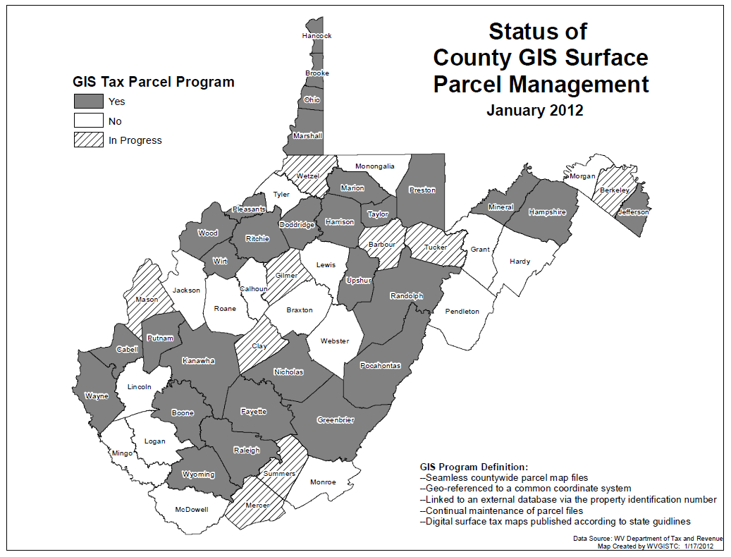

Slide 16
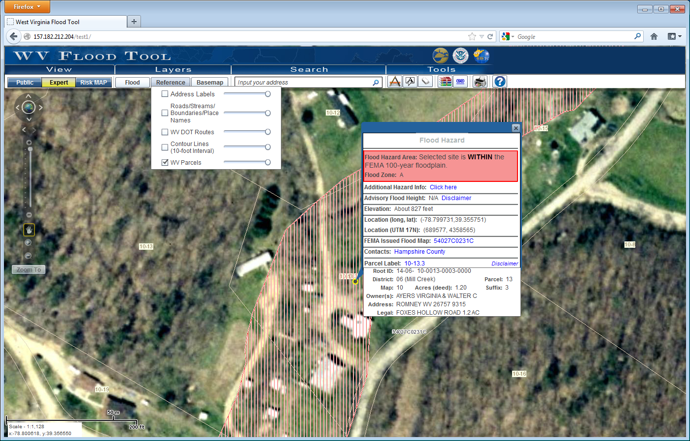
Parcel Web Map Service
WVGISTC Web Map Service
Web: http://services.wvgis.wvu.edu/ArcGIS/rest/services
ArcMap: services.wvgis.wvu.edu/ArcGIS/services

Slide 17
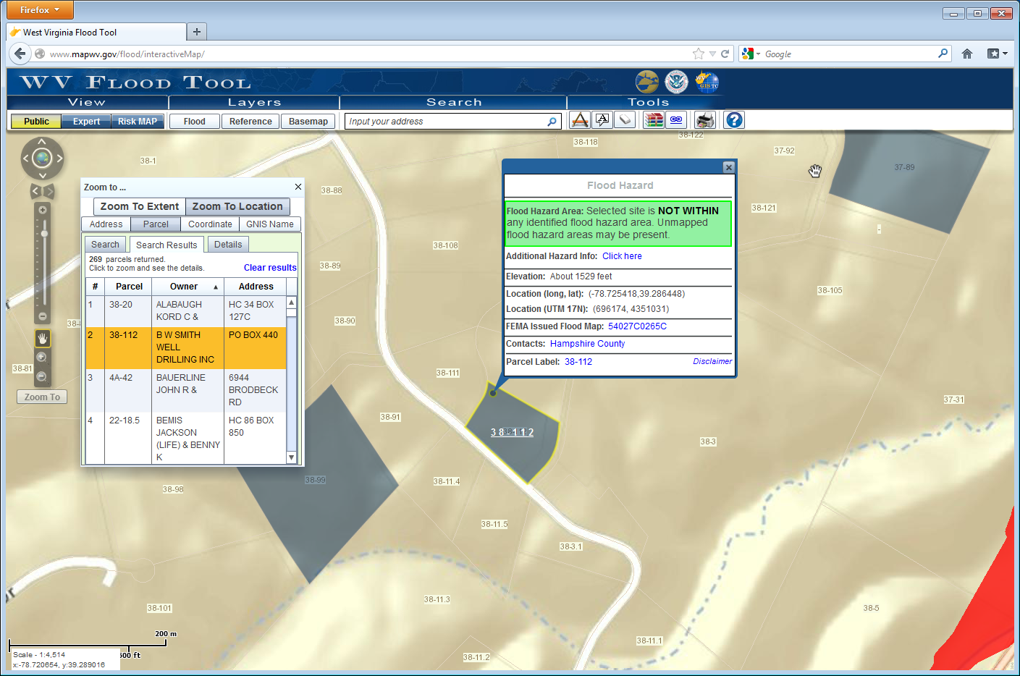
Parcel Query

Slide 18
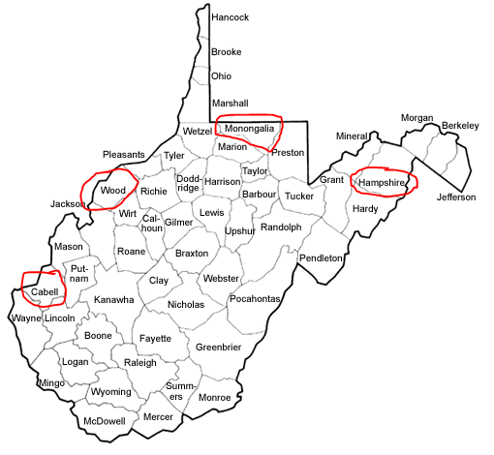
Parcels Availability for Web Map Service
Surface tax parcels provided by counties
For viewing purposes only

Slide 19
Streams Maintenance
(1) 1:24K National Hydrography Dataset (NHD). USGS funded maintenance for 74 miles across 143 NHD features within the Gauley River watershed. New NHD editing tools utilized.
(2) 1:4800 SAMB Local Resolution (2003)

Slide 20
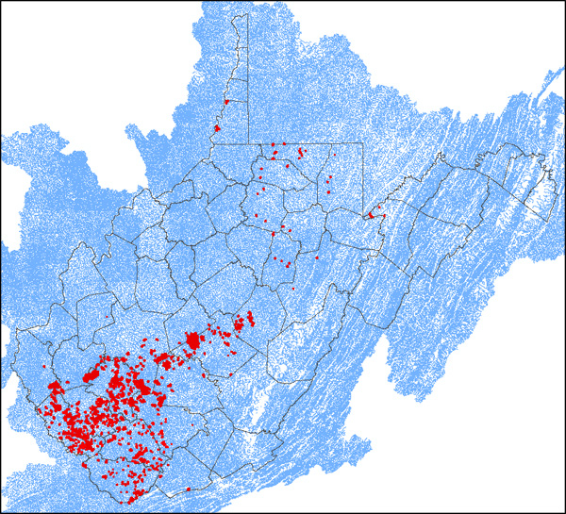
NHD Steams Updated in Mined Areas
Mined area with effected streams marked (red)
2,000 High Resolution NHD features with an estimated length of 800 miles have been impacted by surface mining and require editing.

Slide 21
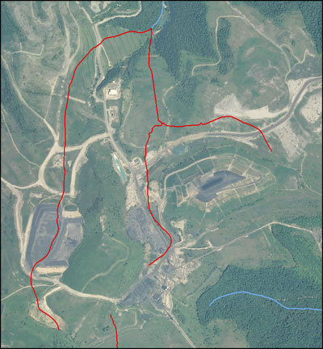
Steams Updated in Mined Areas
Mined area with effected streams marked (red)
USGS funded project

Slide 22
Geographic Names Updated
arenas
auditoriums
bridges
cemeteries
city and town halls
convention and conference centers
courthouses
fire stations
golf courses
hospitals
libraries
museums
police stations
post offices
prisons
schools
shopping centers
stadiums
summits
theaters
USGS funding updated 20 GNIS cultural feature classes, including 3,773 features identities

Slide 23
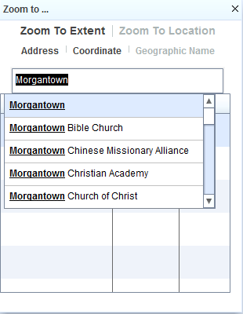
Zoom to Geographic Name

Slide 24
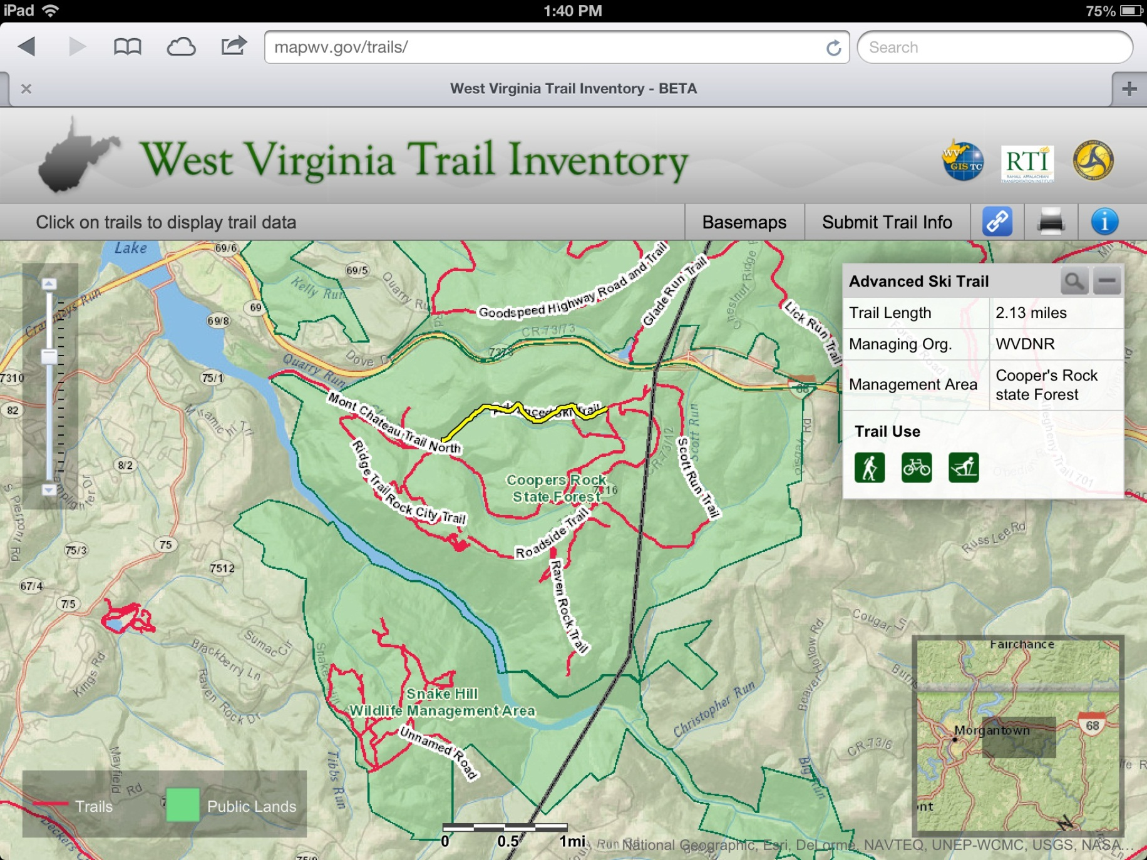
WVDOT Trails Database (iPad)

Slide 25
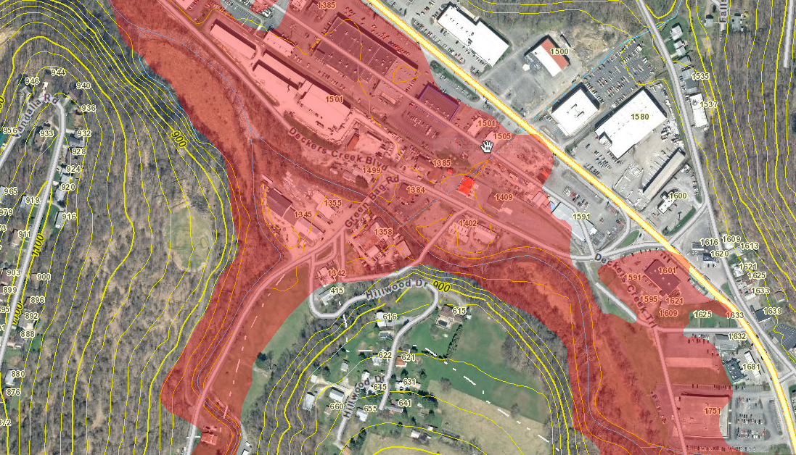
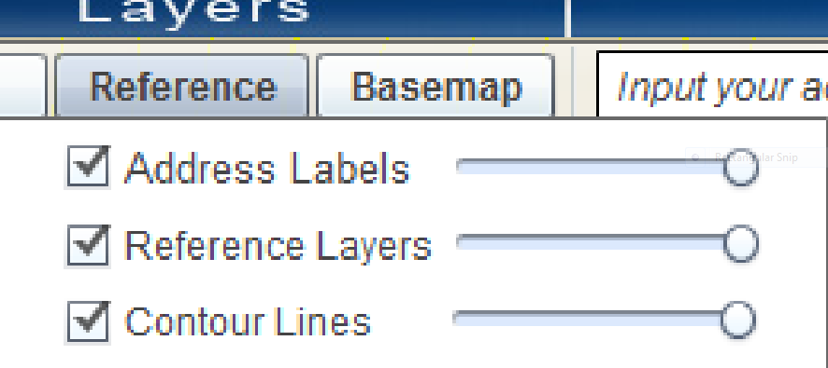
Address Labels as Reference Layer

Slide 26
West Virginia
Site & Street
Locator Services
Build Reference Data
Extract data from SAMS
Create statewide point and street reference files
Build Locator
Services
Publish WV Site (point) and WV Street Locator Services
Search
Addresses
Customized Applications
(WV Flood Tool)
Search by Table
Update and enhance address locators
Search by individual address
Geocoding Services created
from WVDHSEM Statewide Addressing & Mapping System

Slide 27
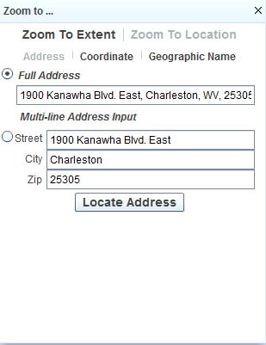
Zoom to Address

Slide 28
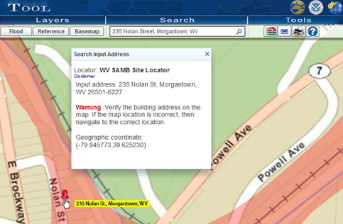
Search on Address
Search on Address
Address Match with WV Site Locator

Slide 29
Other Framework Data Notes
Statewide Roads
  Major Roads from WV DOT
  Local Roads from Census 2010
Boundaries (county, municipal)
  WVAGP sponsored BAS training in 2012
Land Cover
  WV DNR/NRAC created new land cover from 2011 NAIP
Elevation
  WVDEP/WVU NRAC have collected LiDAR for 96% of southern coalfields.
    Coverage and Metadata: http://tagis.dep.wv.gov/lidar.
    Download from WV View: http://www.wvview.org
  WV DEP created aggregate hillshade Web map service
  WVGISTC created 10 ft. contour Web map service
Framework data layers are often published as
Web map services

Slide 30
Consuming Web Map Services
Online Application
Commercial Map Services (ESRI, Bing)
Geocoding Services (state and national sources)
Geoprocessing & Query Map
Services
WV Map & Web Services
(WV DHSEM, WV DEP, WVGISTC)
GIS Data from federal, state, and local agencies

Slide 31
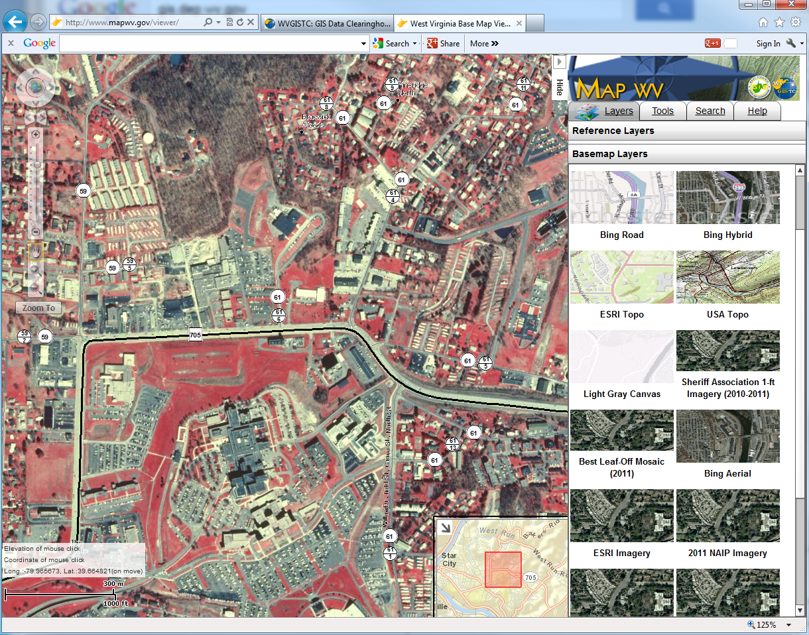
MapWV Viewer (Shared Services)
Shared Data Services Seamless to Users
CIR image and roads consumed from WV DEP & WV DOT Servers

Slide 32
Questions???
Kurt Donaldson
WV GIS Technical Center
kdonalds@wvu.edu
(304) 293-9467

